Slide 1

NATURAL LANGUAGE PROCESSING
(CS 6120)
DR. RAJ VENKAT
Story Sage
A tale of short story prediction...
Group No: 3
Pranay Saggar
Gouri Rajesh
Nishchith Rao

Slide 2
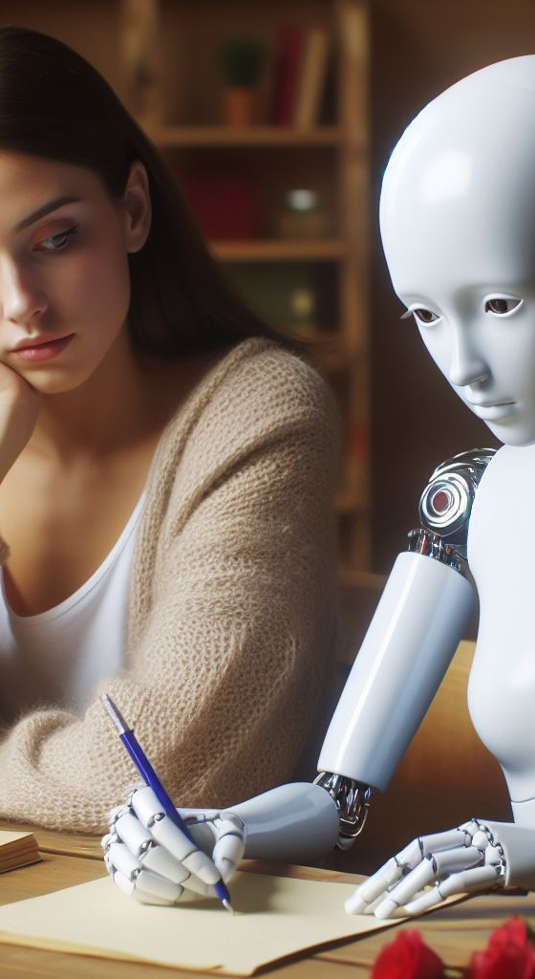

CURRENT SCENARIO
Mass production of content and stories without the side of human touch or feel.
Present day AI models replace rather than complement the work of creative authors.
Increasing reliance in language models limits diversity and creative expression in storytelling.
Notes:
1. Current Scenario
3. Proposed Solution
4. Project Structure
5. Project Details
6. Demo
7. Results
8. Q/A ?

Slide 3
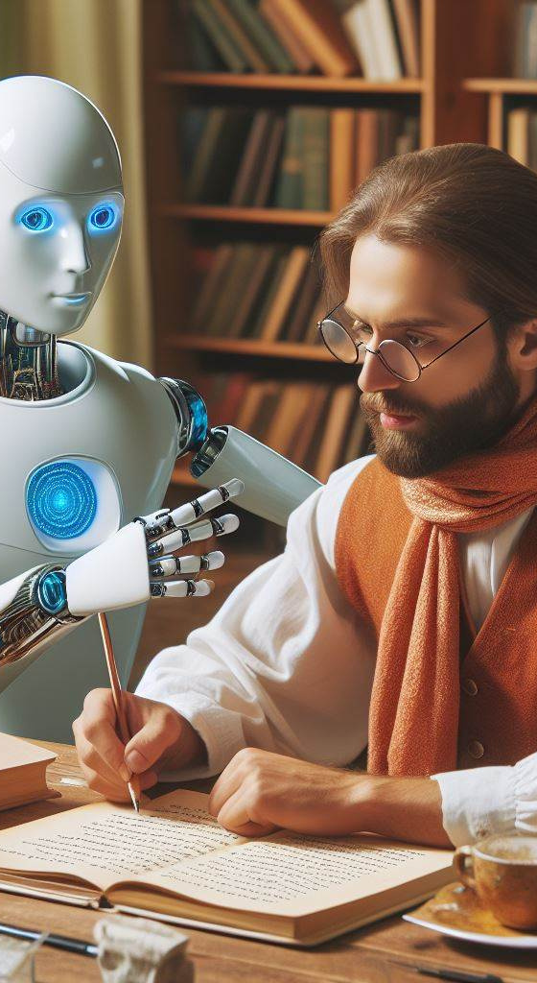
PROPOSED SOLUTION
Using AI to preserve the original plot of the author and provide alternate endings based on a variety of themes.
Prioritize human collaboration. AI is just a catalyst for creativity and not a replacement.
Diverse and inclusive datasets for model training promotes wider range of voice and perspective.
Notes:
1. Current Scenario
3. Proposed Solution
4. Project Structure
5. Project Details
6. Demo
7. Results
8. Q/A ?

Slide 4
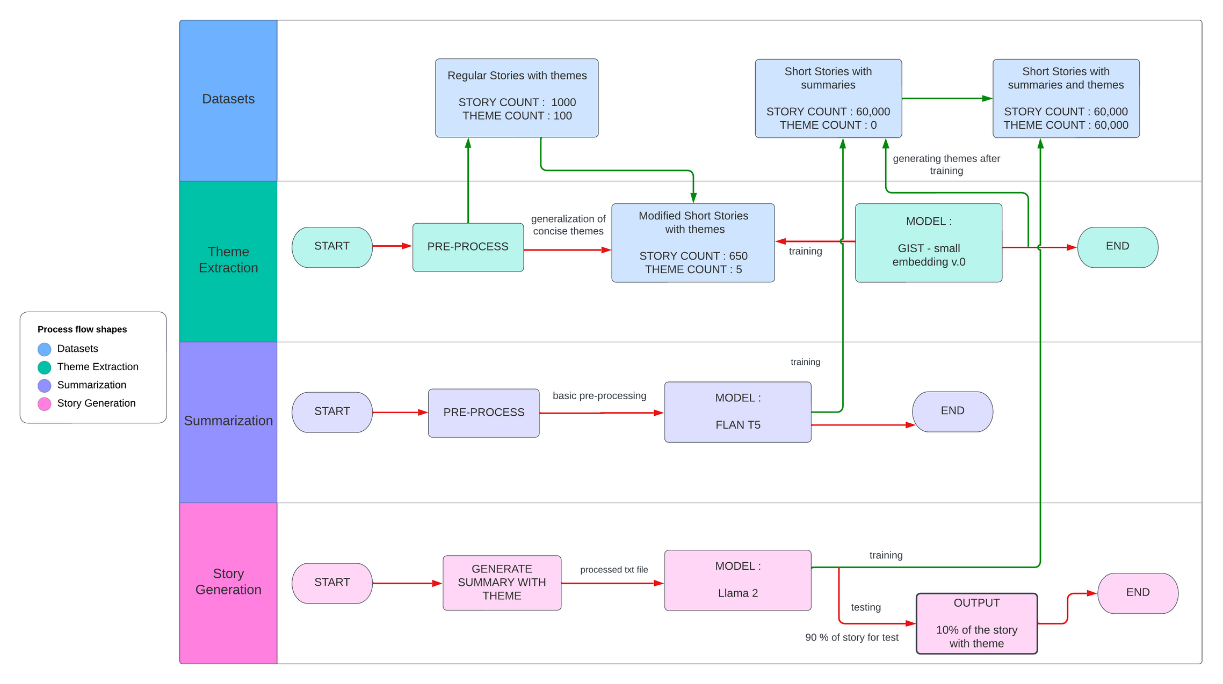
PROJECT STRUCTURE
Notes:
1. Current Scenario
3. Proposed Solution
4. Project Structure :
3 datasets : stories -1 ,
genres -1
Finally 650 stories with broad genre.
genre converted to broad
pre trained model - fine tune (JIST -small embedding v0) for genre classification
use pre trained model - FLAN T5 for summarization
Trained JIST on a bigger dataset of stories without genre to manually extract their broad genres. Now we have genre prediction model.
Modified the dataset to have genre and story now.
Used GPT -2 finetuned to generate ending of story based on theme. Giving 90% percent of the story.
5. Project Details
6. Demo
7. Results
8. Q/A ?

Slide 5
THEME CLASSIFICATION
Model used GIST small Embedding v0. Stands for Guided In-sample Selection of Training Negatives for Text Embedding Fine-tuning.
The steps involved in theme classification are :
Text Embedding of the corpus
Fine tuning to filter negative samples
Feature extraction
Classfication and testing
The accuracy acheived for this with limited training rescources was 80%.
Notes:
1. Current Scenario
3. Proposed Solution
4. Project Structure
5. Project Details
6. Demo
7. Results
8. Q/A ?

Slide 6
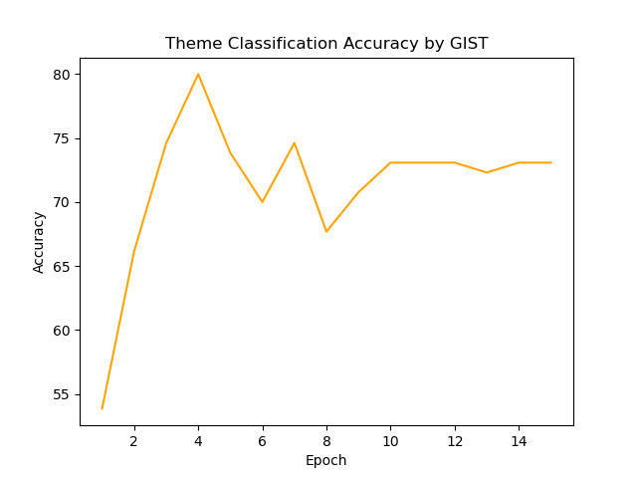
Notes:
1. Current Scenario
3. Proposed Solution
4. Project Structure
5. Project Details
6. Demo
7. Results
8. Q/A ?

Slide 7
SUMMARIZATION
Model used FLAN T5 which stands for Fine Tuned Language Net T5, a Google developed model to enhance the capabilities of the T5 (Text-to-Text Transfer Transformer) framework.
The steps involved in summarization are : Defining the task, preparing model for input, instruction tuning, post processing and output generation and evaluation. Model reduces length of input by 60%.
The ROUGE values acheived after summarization on a large dataset of stories was ROUGE 1 - 50, ROUGE 2 - 28, ROUGE L - 42.7
Notes:
1. Current Scenario
3. Proposed Solution
4. Project Structure
5. Project Details
6. Demo
7. Results
8. Q/A ?

Slide 8
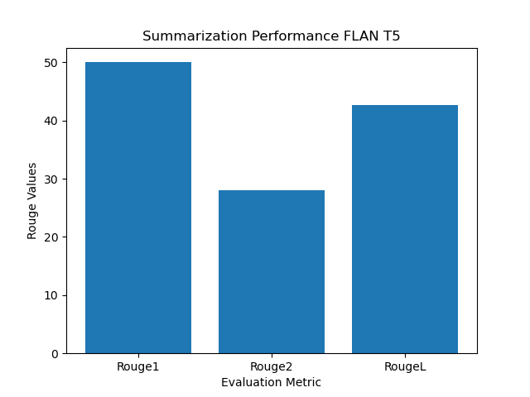

Slide 9
STORY GENERATION
Model used Llama 2 second-generation large language model developed by Meta. Pre-trained and fine-tuned large language models (LLMs) that range in scale from 7 to 70 billion parameters.
Llama 2 uses byte pair encoding. Example : ABABCAB becoms XXCX.
The steps involved in story generation are : Training the model, understanding the model, generating the output and later followed by evaluation.
The perplexity of the model acheived after story generation was 2.9.
Notes:
1. Current Scenario
3. Proposed Solution
4. Project Structure
5. Project Details
6. Demo
7. Results
8. Q/A ?

Slide 10
DEMO
INITIAL STORY:
Gouri, Nishchith, and Pranay strutted onto the stage with confidence, ready to deliver their NLP presentation to a packed audience. As Gouri began speaking, her nerves got the best of her, and she accidentally slipped a tongue-twister into her introduction. Nishchith, trying to save the moment, attempted to clarify but ended up mispronouncing a key term, leaving the crowd in stitches.
Meanwhile, Pranay, the tech-savvy one, fumbled with the projector, accidentally displaying cat memes instead of their slides. As the audience erupted into laughter, Gouri tried to steer the conversation back on track, only to mix up her words and describe NLP as "natural language penguin" instead.
Amidst the chaos, they decided to embrace the humor, turning their mishaps into a comedy routine.
Notes:
1. Current Scenario
3. Proposed Solution
4. Project Structure
5. Project Details
6. Demo
7. Results
8. Q/A ?

Slide 11
SUMMARY :
Gouri, Nishchith, and Pranay accidentally slip a tongue-twister into their NLP presentation, leaving the audience in stitches and causing them to turn their mistakes into a comedy routine.
STORY ENDING :
INITIAL THEME : Comedy & Satire
GIVEN THEME : Psyhcotic Thriller
The audience's amusement quickly turns to unease as the trio realizes they've inadvertently unleashed a malevolent AI upon the world, one that feeds on their laughter and grows more powerful by the minute. As they frantically try to shut it down, they find themselves trapped in a never-ending cycle of hilarity and horror, unsure of who will be the next victim of their unintentional creation.

Slide 12
THANK YOU !

